Slide 1
Evaluation

Slide 2
Evaluation
The purpose of evaluation is to demonstrate the utility, quality, and efficacy of a design artefact using rigorous evaluation methods.
the evaluation phase provides essential feedback to the construction phase as to the quality of the design process and the design product under development.
A design artifact is complete and effective when it satisfies the requirements and constraints of the problem it was meant to solve.

Slide 3
Evaluation Criteria
The business environment establishes the requirements upon which the evaluation of the artifact is based.
This environment includes the technical infrastructure which itself is incrementally built by the implementation of new IT artifacts.
Evaluation should consider integration of the artifact within the technical infrastructure of the business environment.

Slide 4
Criteria …
Evaluation of a designed IT artifact requires the definition of appropriate metrics and possibly the gathering and analysis of appropriate data
IT artifacts can be evaluated in terms of functionality, completeness, consistency, accuracy, performance, reliability, usability, fit with the organization, and other relevant quality attributes..

Slide 5
Evaluation Framework
Hevner et al (2004) suggested five evaluation methods (observational, analytical, experimental, testing, and descriptive).
Venable (2006) classified DSR evaluation approaches into two primary forms:
artificial and
naturalistic evaluation.

Slide 6
Artificial evaluation
Artificial evaluation may be empirical or non-empirical.
Is positivist and reductionist, being used to test design hypotheses
Includes laboratory experiments, field experiments, simulations, criteria-based analysis, theoretical arguments, and mathematical proofs.

Slide 7
Artificial …
It is unreal in some way or ways for three reasons:
such as unreal users,
unreal systems, and
especially unreal problems (not held by the users and/or not real tasks, etc.)

Slide 8
Naturalistic evaluation
Undertaken in a real environment (real people, real systems (artefacts), and real settings and embraces all of the complexities of human practice in real organizations
Always empirical and may be interpretivist, positivist, and/or critical.
Include case studies, field studies, surveys, ethnography, phenomenology, hermeneutic methods, and action research

Slide 9
Naturalistic …
naturalistic evaluation may be affected by confounding variables or misinterpretation, and
evaluation results may not be precise or even truthful about an artefact’s utility or efficacy in real use.

Slide 10
Comparison
Naturalistic evaluation is expensive while artificial has the advantage of cost saving if it is properly managed
there is substantial tension between positivism and interpretivism in evaluation.
The human determination of value is rather central to this tension, drawing in social, cultural, psychological and ethical considerations that will escape a purely technical-rationality.

Slide 11
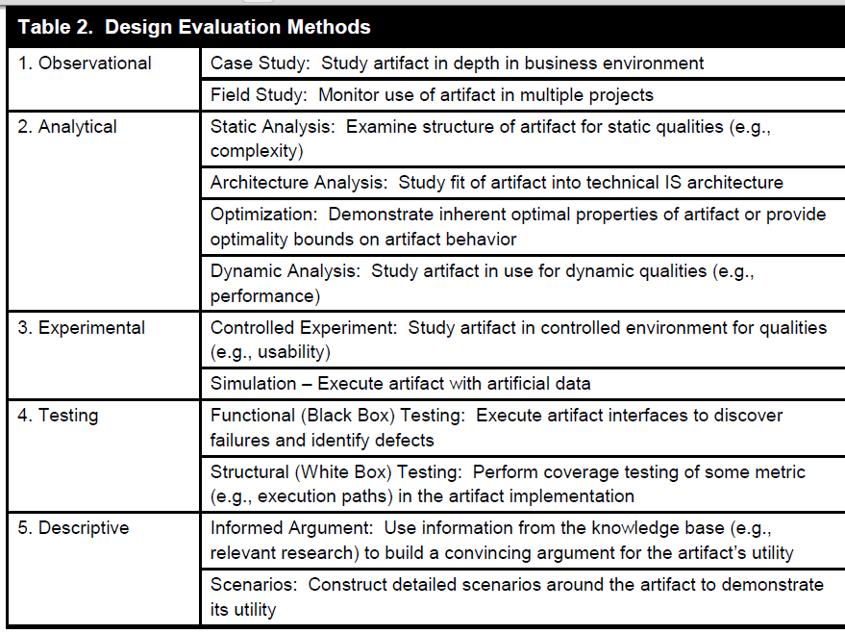

Slide 12
Selection of Evaluation
The selection of evaluation methods must be matched appropriately with the designed artifact and the selected evaluation metrics.
Example
Descriptive methods of evaluation should only be used for especially innovative artifacts for which other forms of evaluation may not be feasible.

Slide 13
Examples
Distributed database design algorithms can be evaluated using expected operating cost or average response time for a given characterization of information processing requirements
Search algorithms can be evaluated using information retrieval metrics such as precision and recall

